Slide 1
Machine Learning Lecture – 1.2
Machine Learning Model

Slide 2
Before discussing the machine learning model, we must need to understand the following formal definition of ML given by professor Mitchell −
“A computer program is said to learn from experience E with respect to some class of tasks T and performance measure P, if its performance at tasks in T, as measured by P, improves with experience E.”

Slide 3
The above definition is basically focusing on three parameters, also the main components of any learning algorithm, namely Task(T), Performance(P) and experience (E). In this context, we can simplify this definition as −
ML is a field of AI consisting of learning algorithms that −
Improve their performance (P)
At executing some task (T)
Over time with experience (E)

Slide 4
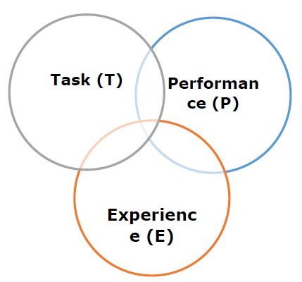

Slide 5
Task(T)
From the perspective of problem, we may define the task T as the real-world problem to be solved. The problem can be anything like finding best house price in a specific location or to find best marketing strategy etc. On the other hand, if we talk about machine learning, the definition of task is different because it is difficult to solve ML based tasks by conventional programming approach.
A task T is said to be a ML based task when it is based on the process and the system must follow for operating on data points. The examples of ML based tasks are Classification, Regression, Structured annotation, Clustering, Transcription etc.

Slide 6
Experience (E)
As name suggests, it is the knowledge gained from data points provided to the algorithm or model. Once provided with the dataset, the model will run iteratively and will learn some inherent pattern. The learning thus acquired is called experience(E). Making an analogy with human learning, we can think of this situation as in which a human being is learning or gaining some experience from various attributes like situation, relationships etc. Supervised, unsupervised and reinforcement learning are some ways to learn or gain experience. The experience gained by out ML model or algorithm will be used to solve the task T.

Slide 7
Performance (P)
An ML algorithm is supposed to perform task and gain experience with the passage of time. The measure which tells whether ML algorithm is performing as per expectation or not is its performance (P). P is basically a quantitative metric that tells how a model is performing the task, T, using its experience, E. There are many metrics that help to understand the ML performance, such as accuracy score, F1 score, confusion matrix, precision, recall, sensitivity etc.

Slide 8
Challenges in Machines Learning
While Machine Learning is rapidly evolving, making significant strides with cybersecurity and autonomous cars, this segment of AI as whole still has a long way to go. The reason behind is that ML has not been able to overcome number of challenges. The challenges that ML is facing currently are −
Quality of data − Having good-quality data for ML algorithms is one of the biggest challenges. Use of low-quality data leads to the problems related to data preprocessing and feature extraction.
Time-Consuming task − Another challenge faced by ML models is the consumption of time especially for data acquisition, feature extraction and retrieval.
Lack of specialist persons − As ML technology is still in its infancy stage, availability of expert resources is a tough job.

Slide 9
No clear objective for formulating business problems − Having no clear objective and well-defined goal for business problems is another key challenge for ML because this technology is not that mature yet.
Issue of overfitting & underfitting − If the model is overfitting or underfitting, it cannot be represented well for the problem.
Curse of dimensionality − Another challenge ML model faces is too many features of data points. This can be a real hindrance.
Difficulty in deployment − Complexity of the ML model makes it quite difficult to be deployed in real life.

Slide 10
Applications of Machines Learning
Machine Learning is the most rapidly growing technology and according to researchers we are in the golden year of AI and ML. It is used to solve many real-world complex problems which cannot be solved with traditional approach. Following are some real-world applications of ML −
Emotion analysis
Sentiment analysis
Error detection and prevention
Weather forecasting and prediction
Stock market analysis and forecasting
Speech synthesis
Speech recognition
Customer segmentation
Object recognition
Fraud detection
Fraud prevention
Recommendation of products to customer in online shopping

Slide 11
Methods of Machine Learning
There are various ML algorithms, techniques and methods that can be used to build models for solving real-life problems by using data. In this chapter, we are going to discuss such different kinds of methods.
Different Types of Methods
The following are various ML methods based on some broad categories −
Based on human supervision
Unsupervised Learning
Semi-supervised Learning
Reinforcement Learning

Slide 12
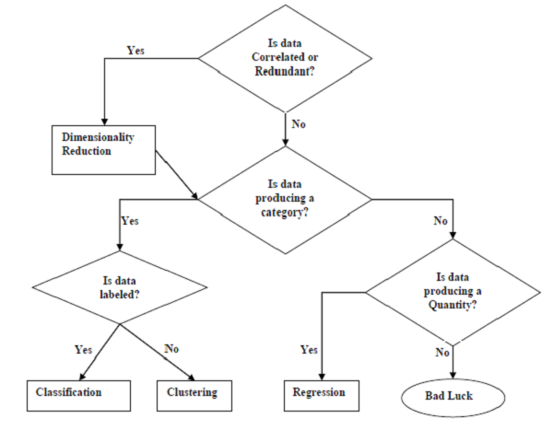
Tasks Suited for Machine Learning - The following diagram shows what type of task is appropriate for various ML problems −

Slide 13
Based on learning ability
In the learning process, the following are some methods that are based on learning ability −
Batch Learning
In many cases, we have end-to-end Machine Learning systems in which we need to train the model in one go by using whole available training data. Such kind of learning method or algorithm is called Batch or Offline learning. It is called Batch or Offline learning because it is a one-time procedure and the model will be trained with data in one single batch. The following are the main steps of Batch learning methods −
Step 1 − First, we need to collect all the training data for start training the model.
Step 2 − Now, start the training of model by providing whole training data in one go.
Step 3 − Next, stop learning/training process once you got satisfactory results/performance.
Step 4 − Finally, deploy this trained model into production. Here, it will predict the output for new data sample.

Slide 14
Online Learning
It is completely opposite to the batch or offline learning methods. In these learning methods, the training data is supplied in multiple incremental batches, called mini-batches, to the algorithm. Followings are the main steps of Online learning methods −
Step 1 − First, we need to collect all the training data for starting training of the model.
Step 2 − Now, start the training of model by providing a mini-batch of training data to the algorithm.
Step 3 − Next, we need to provide the mini-batches of training data in multiple increments to the algorithm.
Step 4 − As it will not stop like batch learning hence after providing whole training data in mini-batches, provide new data samples also to it.
Step 5 − Finally, it will keep learning over a period of time based on the new data samples.

Slide 15
Based on Generalization Approach
In the learning process, followings are some methods that are based on generalization approaches −
Instance based Learning
Instance based learning method is one of the useful methods that build the ML models by doing generalization based on the input data. It is opposite to the previously studied learning methods in the way that this kind of learning involves ML systems as well as methods that uses the raw data points themselves to draw the outcomes for newer data samples without building an explicit model on training data.
In simple words, instance-based learning basically starts working by looking at the input data points and then using a similarity metric, it will generalize and predict the new data points.

Slide 16
Model based Learning
In Model based learning methods, an iterative process takes place on the ML models that are built based on various model parameters, called hyperparameters and in which input data is used to extract the features. In this learning, hyperparameters are optimized based on various model validation techniques. That is why we can say that Model based learning methods uses more traditional ML approach towards generalization.

Slide 17
summary
3 parameters - P T E
Flow graph of PTE
Sequence of Task based approach for ML problem.
Methods of Machine Learning – Un-Supervised, Semi-supervised, Reinforcement
Learning ability - Batch, Online, Instance based learning, Model based Learning.

